Slide 1
New Jersey State Board of Education Recognition Slide Show
December 2, 2020
Please note that this document has been modified from its original version to be more accessible.

Slide 2
Congratulations to all the recipients!

Slide 3
Superintendent of the Year Award
Presented by the
New Jersey Association of School Administrators

Slide 4
2021 Superintendent of the Year
Joseph Meloche
Cherry Hill School District

Slide 5
School Business Administrator of the Year Award
Presented by the
New Jersey Association of School Business Officials

Slide 6
2020 School Business Administrator of the Year
Thomas Eldridge
Lawrence Township School District

Slide 7
Visionary Principal of the Year Awards
Presented by the
New Jersey Principals and Supervisors Association

Slide 8
2020 Visionary Principal of the Year Elementary Level
Christian Paskalides
Middle Township Elementary School #1
Middle Township School District

Slide 9
2020 Visionary Principal of the Year Secondary Level
Michael Vinella
East Brunswick High School
East Brunswick School District

Slide 10
State Teacher of the Year Finalists
Presented by the
New Jersey Department of Education

Slide 11
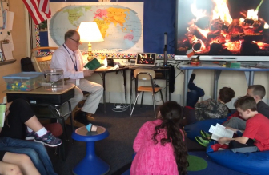
2020-2021 State Teacher of the Year Finalist (slide one of four)
Michael Dunlea
Third Grade Teacher
Tabernacle Elementary School
Tabernacle School District

Slide 12
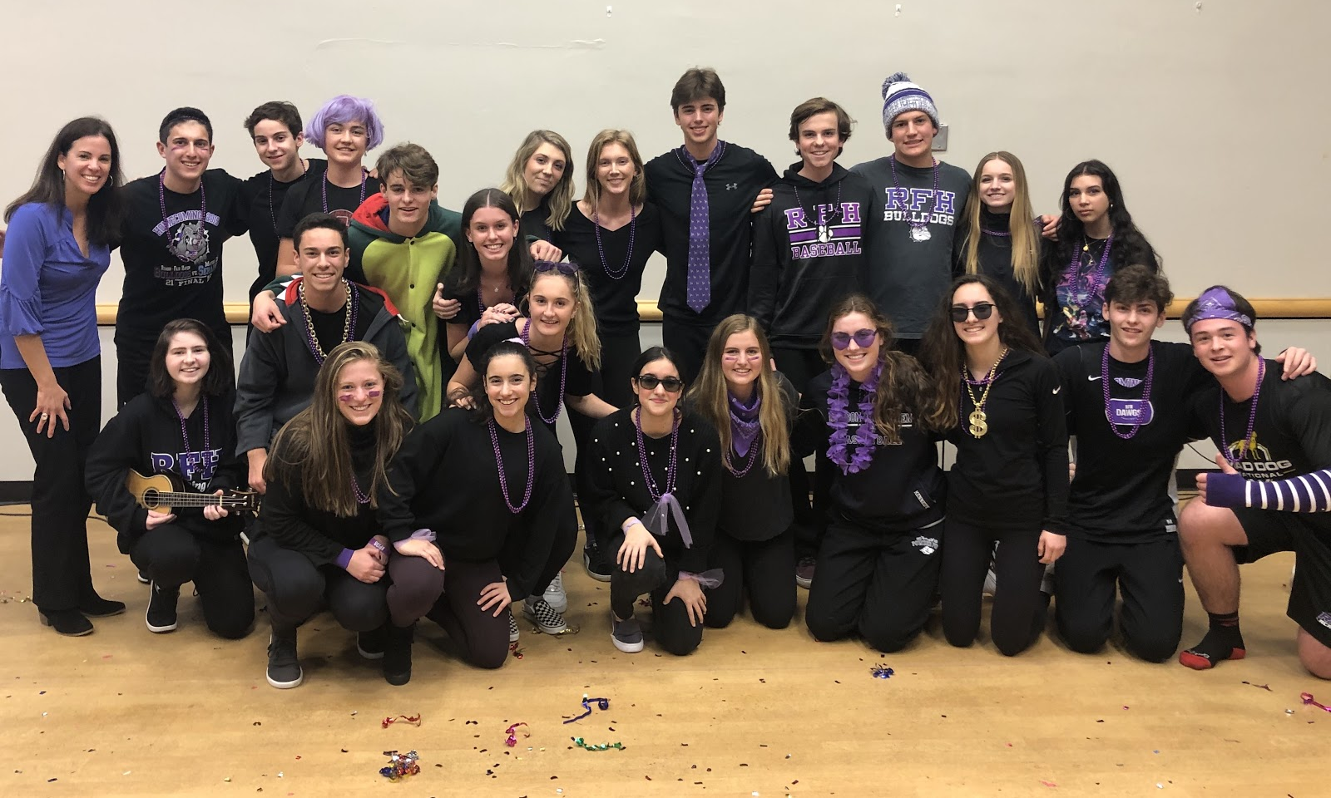
2020-2021 State Teacher of the Year Finalist (slide two of four)
Christina Gauss
Spanish Teacher
Rumson-Fair Haven Reg. High School
Rumson-Fair Haven Reg. School District

Slide 13
2020-2021 State Teacher of the Year Finalist (slide three of four)
Megan Graziano
Science Teacher
Clifton High School
Clifton School District

Slide 14
2020-2021 State Teacher of the Year Finalist (slide four of four)
Rachel Krementz
Special Education Teacher
Ocean Academy
Cape May County Special Services
School District

Slide 15
National Blue Ribbon Schools
Presented by the
United States Department of Education

Slide 16
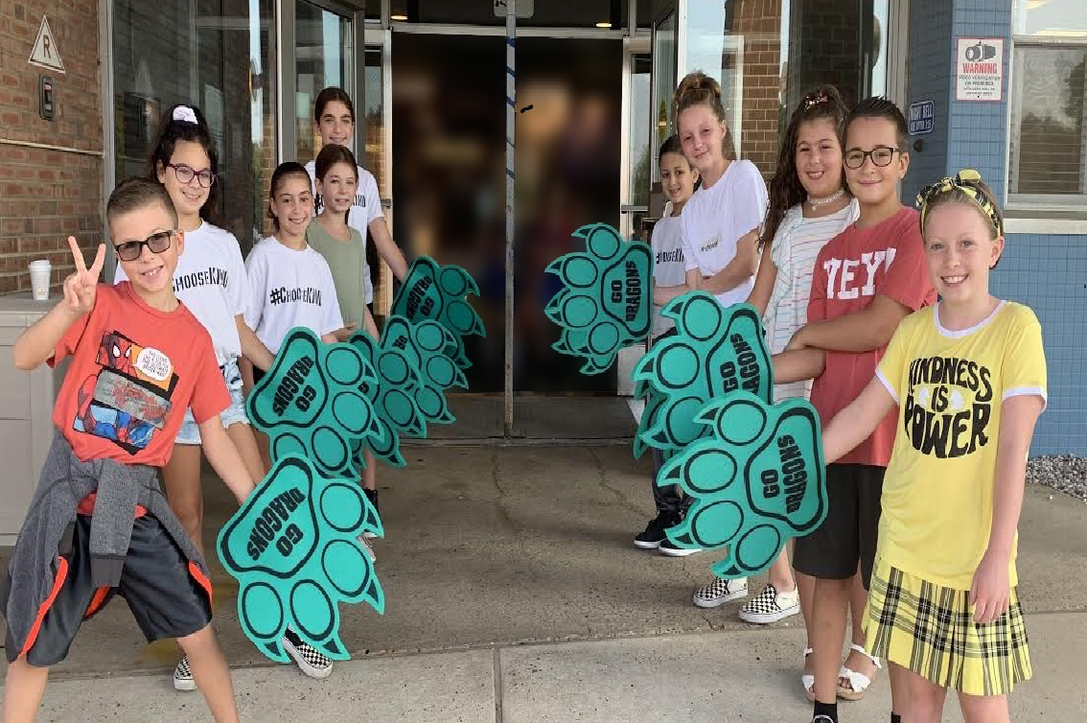
2020 National Blue Ribbon School (slide one of nine)
Clark Mills School
Manalapan-Englishtown
Regional School District

Slide 17
2020 National Blue Ribbon School (slide two of nine)
County Prep High School
Hudson County Schools of
Technology School District

Slide 18
2020 National Blue Ribbon School (slide three of nine)
Gould School
North Caldwell School District

Slide 19
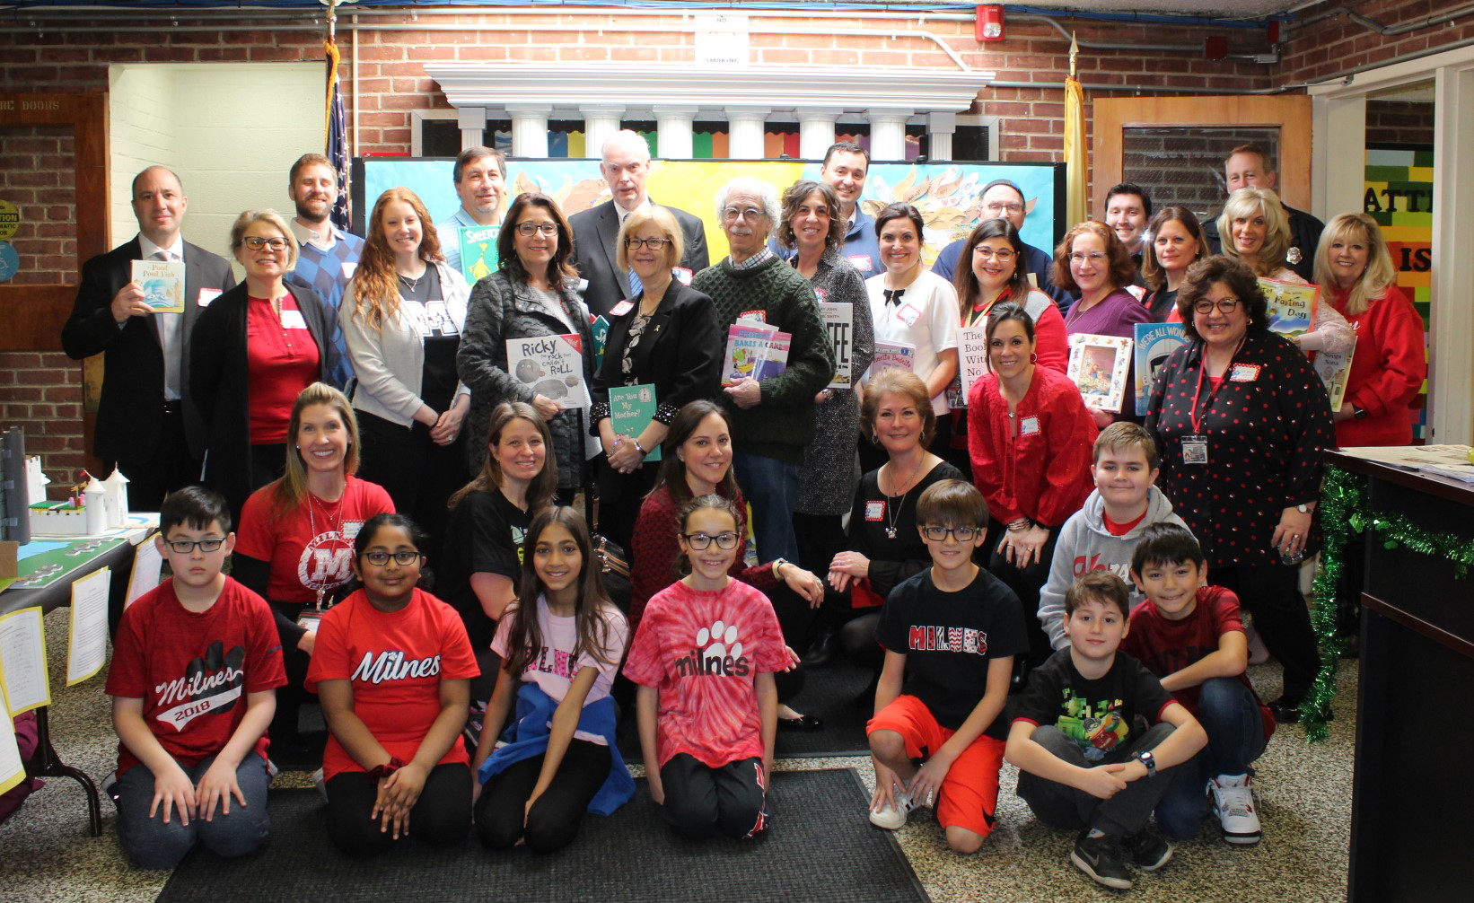
2020 National Blue Ribbon School (slide four of nine)
Henry B. Milnes Elementary School
Fair Lawn School District

Slide 20
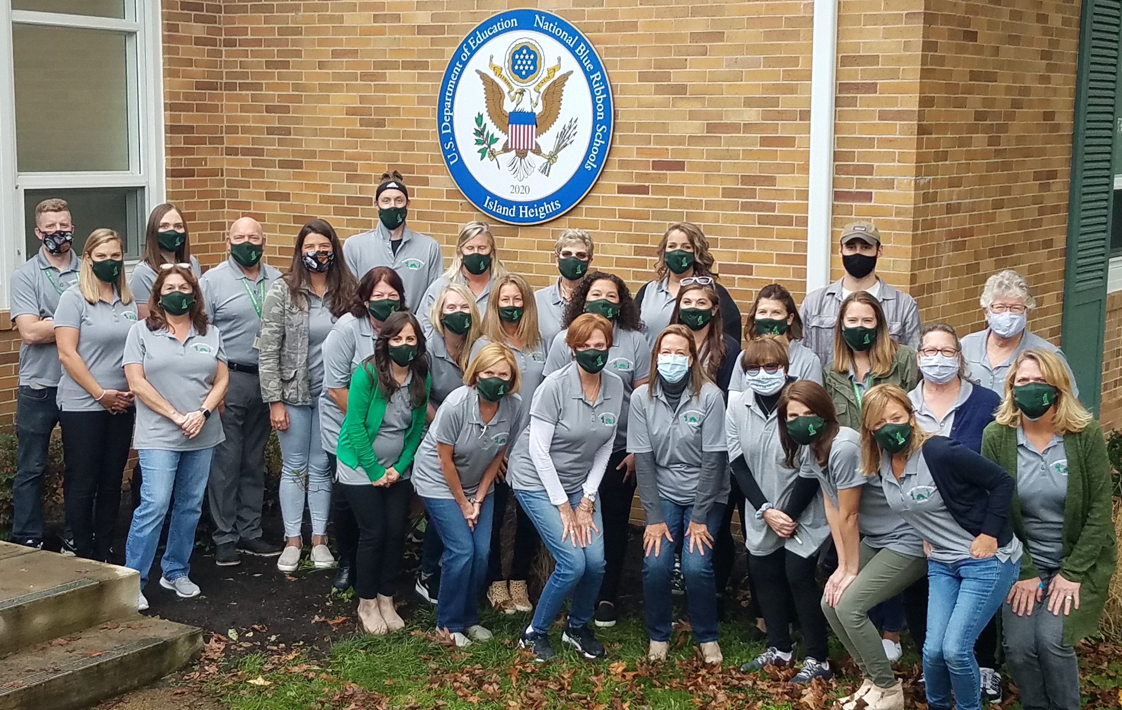
2020 National Blue Ribbon School (slide five of nine)
Island Heights Elementary School
Island Heights School District

Slide 21
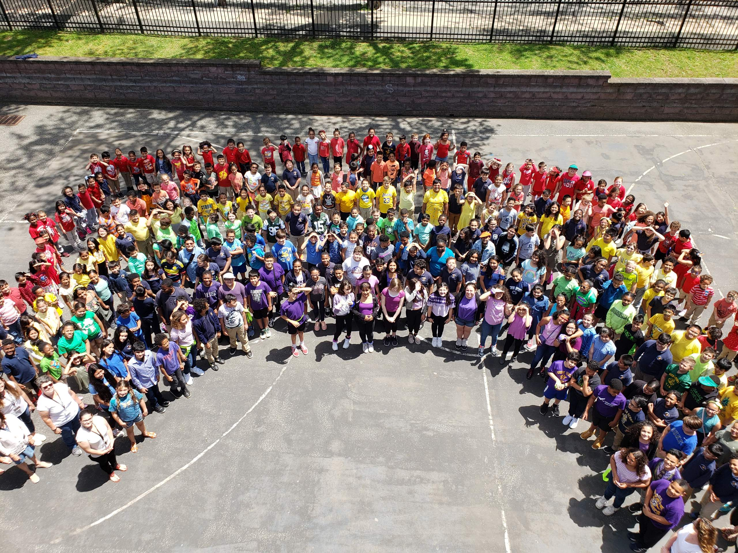
2020 National Blue Ribbon School (slide six of nine)
Lillian M. Steen Elementary School
Bogota School District

Slide 22
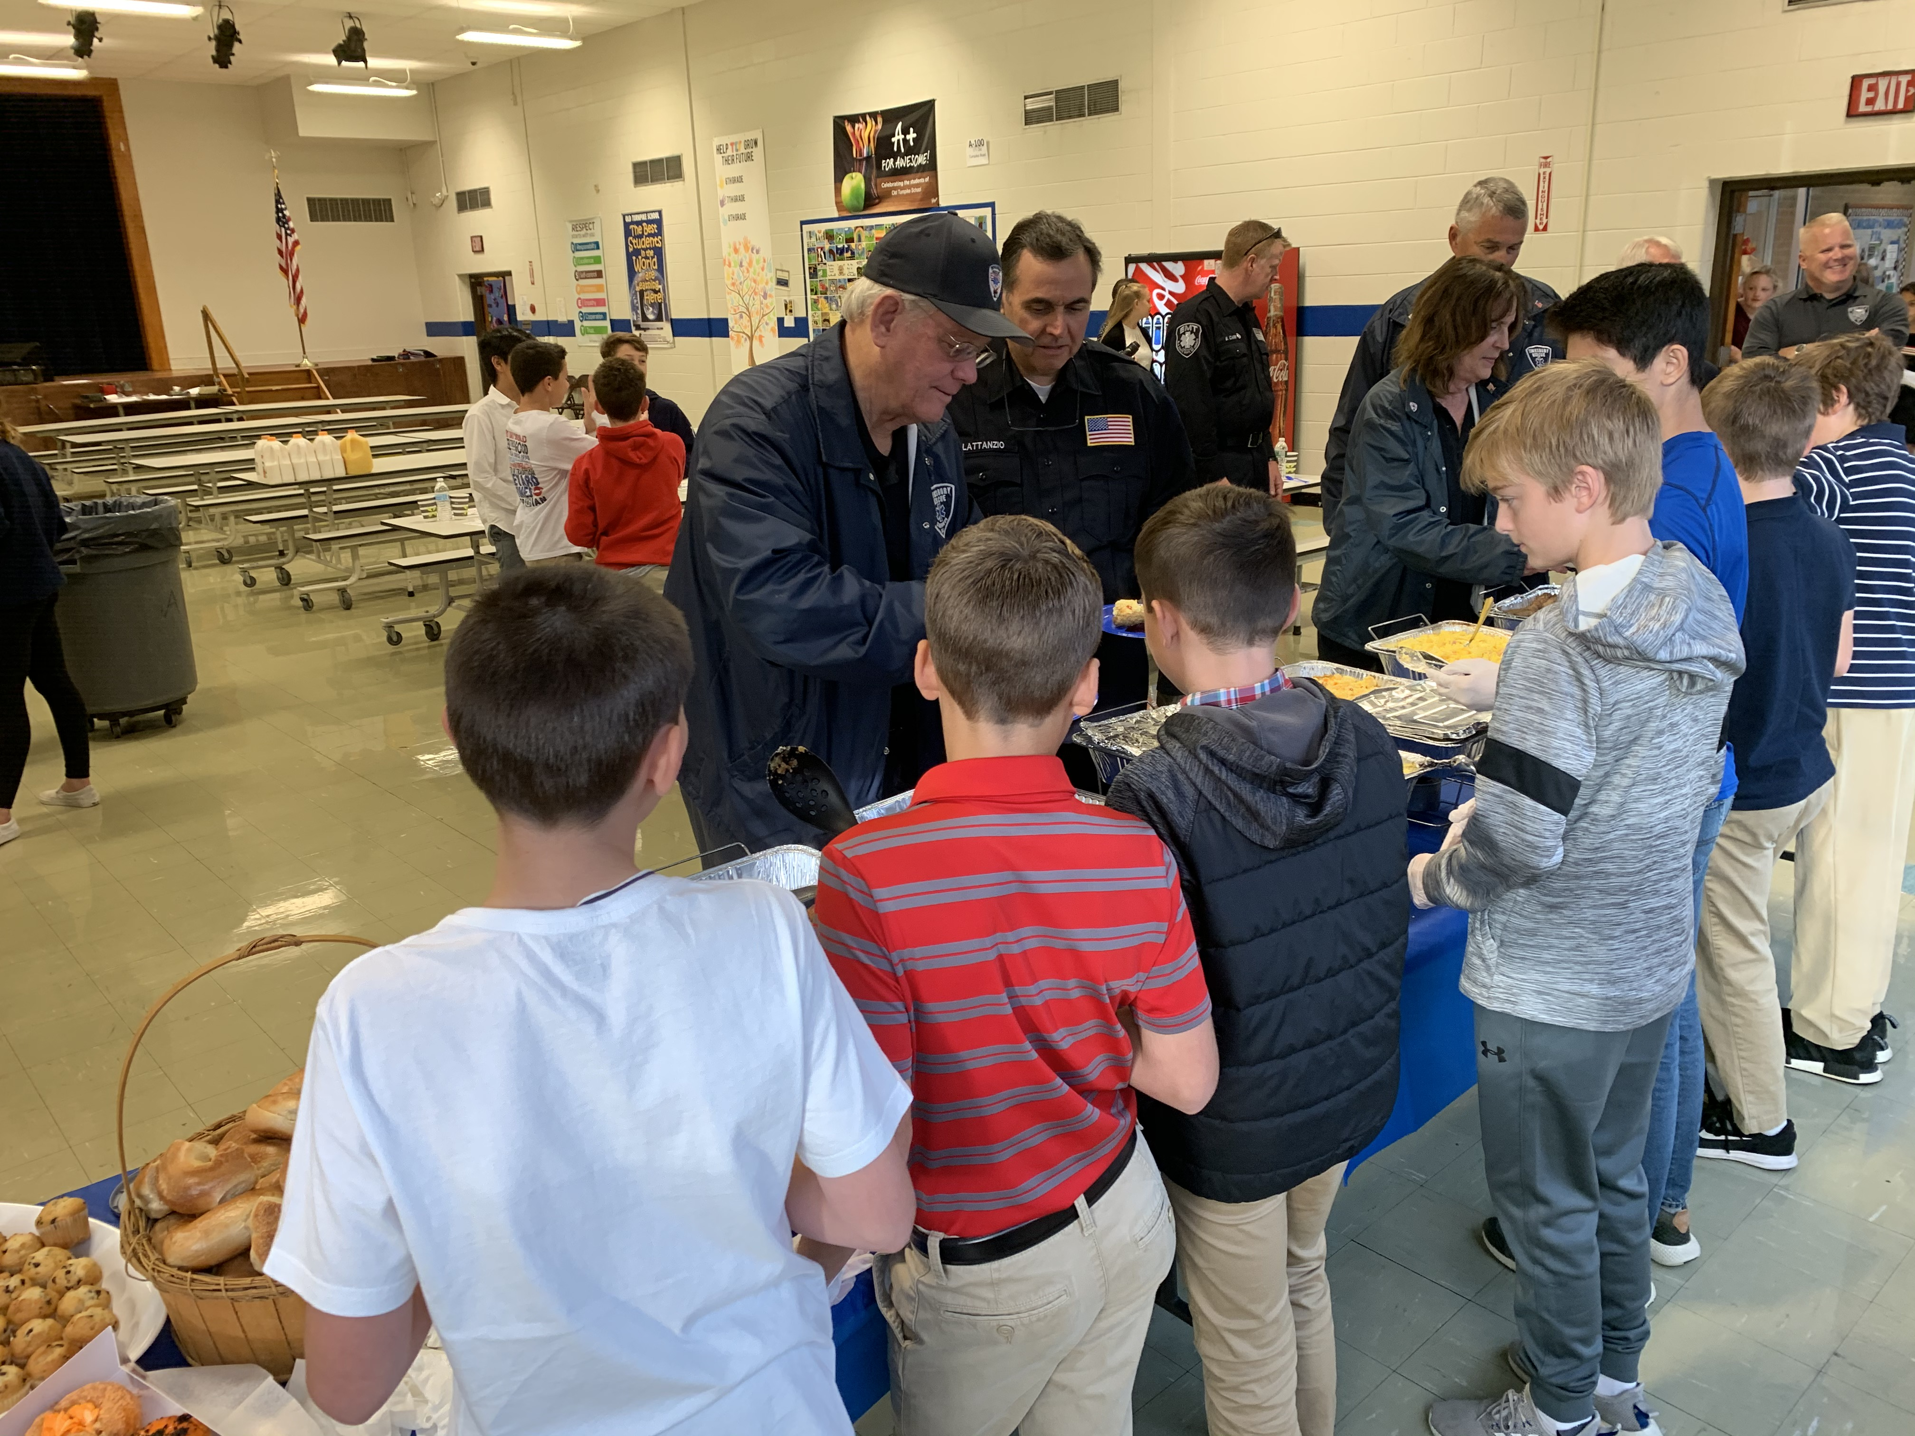
2020 National Blue Ribbon School (slide seven of nine)
Old Turnpike School
Tewksbury School District

Slide 23
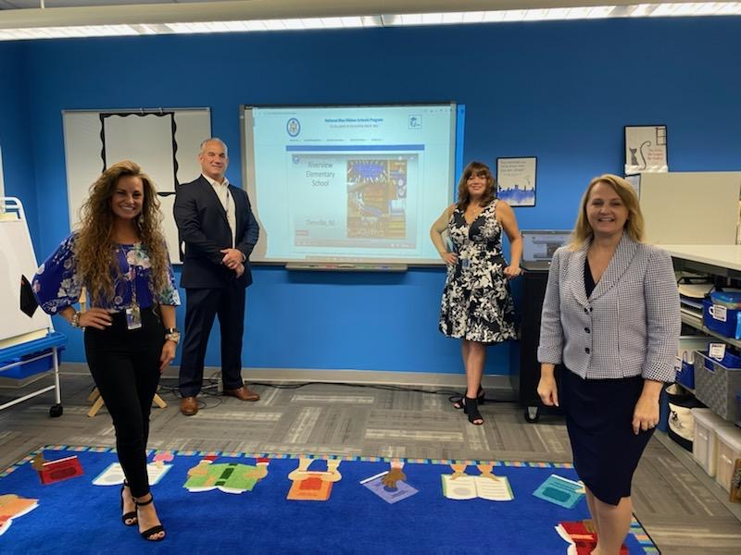
2020 National Blue Ribbon School (slide eight of nine)
Riverview Elementary School
Denville School District

Slide 24
2020 National Blue Ribbon School (slide nine of nine)
School Number 5
Linden School District

Slide 25
National Green Ribbon Schools
Presented by the
United States Department of Education

Slide 26
2020 National Green Ribbon School (slide one of two)
Cape May City Elementary School
Cape May City School District

Slide 27
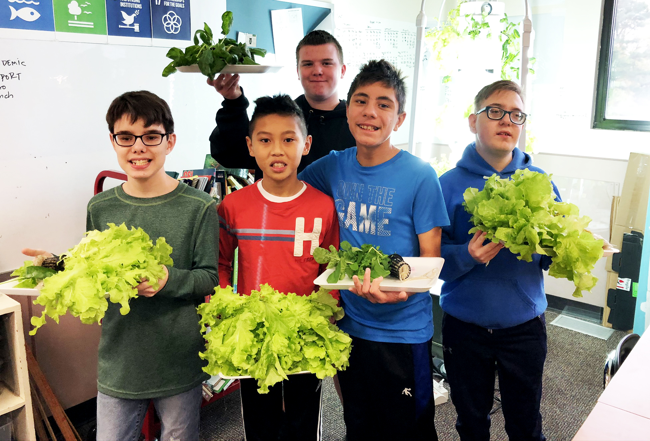
2020 National Green Ribbon School (slide two of two)
Readington Middle School
Readington School District

Slide 28
Congratulations, once again to all the recipients!
Please visit the New Jersey Department of Education’s social media sites to hear remarks from today’s recipients.
@njdeptofed @NewJerseyDOE @newjerseydoe

